Slide 1
Google Earth Engine, AgroServe lit
April 4, 2018

Slide 2
Questions
Regionalizing Brazil
Datasets for the following?
sea surface temp
ENSO index, ITCZ position
possibly the position of the southern hemisphere subtropical jet.
How to classify this information? Number of regions or average size of regions we’re targeting? Will also need lat/long, local and upwind veg cover.
Mapbiomas
The mapbiomas dataset doesn’t have a specific class for soybean. The available types are: open forest, dense forest, natural non forest wetlands, farming, non vegetated area, water, not observed.
If we only want soybean vs. forest, what do we do when there’s urban, water land use types? Do we group all forest types in as one?
Where are we going to put the other types of agriculture that aren’t soybean?
SCYM crop model
Do we need to actually run the crop model simulations and regressions for Brazil, or can we rely on the results of their study in the High Plains? If we need to run it ourselves, how to choose the soil, climate etc. scenarios to run for?
Will the weather variables in the regression calibration step have to change for Brazil?
Does soybean calendar look different for High Plains vs Brazil?
Will we need any kind of ground based validation?
Where to get GEE support on campus?

Slide 4
Mapbiomas: the land cover data we’re using
The mapbiomas web site doesn’t seem to have a specific class for soybean. If we only want soybean vs. forest, what do we do when there’s urban, water land use types? Do we group all forest types in as one? Where are we going to put the other types of agriculture that aren’t soybean?
Where do we find soybean?
The available types are: open forest, dense forest, natural non forest wetlands, farming, non vegetated area, water, not observed. Soybean nowhere to be found…
Imported data to GEE using the asset id provided on http://mapbiomas.org/pages/scripts
Try to visualize Mapbiomas like it appears on http://mapbiomas.org/map#coverage
Has bands representing 2000 to 2016 land covers. Each individual year has only one band, and the value of the band corresponds to a particular land cover type. (need to find out which land cover type corresponds to which number.)
Also has Mapbiomas script– going from Landsat data to the land cover classifications. The script has three layers: Mosaic, NDFI, and Classification. The Classification layer is what we want. The decision tree around line 709 seems to encode the numbers with the land use types, but shouldn’t this information be found in an easier manner? Also not all the land types are defined in this decision tree.
Note that the imported asset MapBiomas_AMAZONIA_2016 isn’t good because it has each land type as a separate band (?), which isn’t easy to visualize on the map. Also there doesn’t seem to be a guarantee that each regional map of Brazil uses the same classification number : land use system.
http://mapbiomas.org/pages/methodology has some info about the band values and land use types associated, but it looks like these change depending on the region of Brazil

Slide 5
(Lobell et al, 2015) the crop model we’re hoping to use
Do we need to actually run the crop model simulations and regressions for every single field, or can we rely on the results of their study in the High Plains? What will be the input data for this model – Landsat? Is the crop model that they used (APSIM) also applicable to Brazil? Will the weather variables in the regression calibration step have to change for Brazil?
Web site: http://www.g-feed.com/2015/05/introducing-scym.html
The basic idea is that if you don’t have lots of ground data to calibrate a model, why not generate lots of fake ground data? Then for whatever combination of observations you actually have (say, satellite images on 2 or 3 specific days and measures of daily weather), you can look into your fake data to see what the best fit model is to predict the desired variable (“yield”) from the measured predictors.
The crop model is called SCYM for scalable satellite-based crop yield mapper. It uses crop model simulations to train statistical models for different combinations of possible image acquisition dates, and these are then applied to Landsat and gridded weather data in GEE, where the Landsat is composited to find the “best” dates of observations of a pixel by pixel basis. This method can be readily applied to new crops, regions, and types and timing of RS observations without the need for ground calibration (but doesn’t really defend this outside of maize and soybean in High Plains…)
VI = vegetation indices
Existing method often rely on calibrated relationships between VIs that are specific to individual locations and years, which will require new ground truth measurements for each new setting. Other approaches integrate ecophysiological crop models that can accommodate changes in location, weather, and timing of images but often require computationally intensive approaches to data assimilation that require site-specific soil and daily weather data (look at the papers they cited about other crop models. Also read the prior work that this paper builds on.)
Will we need any kind of ground based validation?
Using multiple dates instead of a single date improved crop yield predictions and allows the method to be more robust when extended to new locations or years.
They assessed the potential issue of having a lot of yield variability being artifacts of the use of different observation dates for different pixels. They used three tests and concluded that using different dates for each pixels accounted for only a very small portion of overall yield variability.
They also emphasize that absolute values of yields aren’t critical; rather, we want relative yield of fields compared to their neighbors.

Slide 6
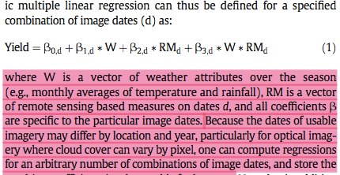
(Lobell et al, 2015) the crop model we’re hoping to use
The SCYM approach:
Crop model simulations: generate a large number of crop model simulations that span on a range of soil, climate and management conditions for a given region. the model outputs LAI, water stress, season-total biomass, yield. Here they used the Agricultural Production Systems Simulator (APSIM) model. Are we using APSIM as well? If not, how do we choose?
Generate psudo-observations: the daily output of the crop model is converted to remotely observable quantities using equations from literature or established with independent datasets (i.e. LAI can be converted to optical-based Vis or radar backscatter, and canopy water stress can be related to thermal measurements. Here they converted LAI to green chlorophyll vegetation index (GCVI). Will we also use GCVI? Does soybean calendar look different for High Plains and Brazil, and if so how do we account for that?
Regression calibrations: the simulated yields and pseudo remote sensing observations can then be combined to train a statistical model. It is a multiple linear regression that considers weather over the season (like monthly avg T and P), remote sensing measures on the dates. Historically this regression was only performed on a specific date (the date the image was obtained), but this model incorporates multiple dates. Because dates of usable imagery differ by location and year, can compute regressions for many combos of image dates and store the resulting coefficients. Here their weather variables were June to Aug rainfall and solar radiation, July daytime vapor pressure deficit, and August daytime max temperature. Look at the papers they cited which chose these variables. The coefficients for each combinations of dates was saved and imported to GEE as a Google Fusion Table (so we’ll have to do Steps 1 to 3 ourselves outside of GEE??)
Yield estimation: apply regression equations to actual measurements obtained from satellite data; this is done on a pixel by pixel basis using the best available observation dates for each pixel. They used GEE to calculate GCVI using Landsat 5 and 7; weather was from Daymet. Calculations were done per pixel. They masked out non-soybean pixels.

Slide 7
If the crop simulation from Lobell et al, 2015 is too much, may go with the following statistical approach. but since these directly link yield to climate, we won’t need any part of Lobell’s work (i.e. the statistical piece wouldn’t just replace the step 1 crop sim part of Lobell’s work; it would replace all four steps? But how about pixel level stuff – because this paper seems to focus on the global scale.
(Moore et al, ) – “new science of climate change impacts on agriculture…”
They looked at how yield is affected by climate changed using two ways:
Used meta-analysis of agronomic literature on how climate change affects crop yields published by Chalinor et al. They present a new analysis of this database and aggregate the results to the global scale. The meta-analysis deliberately smooths out heterogeneity in soil, irrigation, etc to preserve only the heterogeneity resulting from different baseline temperatures.
Agricultural Model Intercomparison and Improvement Project (AgMIP) by Rosenzweig et al. This is the Global Gridded Crop Model Intercomparison (GGCMI). GGCMI results explicitly account for spatial variation resulting from soil type, irrigation, baseline temperature, nutrient limitations. This one is an ensemble of gridded crop model outputs that includes seven process-based crop models, run using five General Circulation Models.
Since AgMIP seems to allow more details (and don’t we want details for the pixels?) then we should focus more on AgMIP? but what about the issue that AgMIP is at global scale?

Slide 8
Dave’s regression model to find rainfall params:
variables that are going to be in the regression model - lat and long, sea surface temp
local and upwind veg cover (forested/deforested % or something), ENSO index, ITCZ position, and possibly the position of the southern hemisphere subtropical jet (for which there is no good index, must be computed from climate data).
for starters Dave is probably just going to use this multi-variate ENSO index: https://www.esrl.noaa.gov/psd/enso/mei/table.html
They keep track of climate indices on this site: https://www.esrl.noaa.gov/psd/data/climateindices/list/
Ideas for classifying this information? (perhaps some range of each variable?) how to determine the degree of “homogeneity” that we want? Number of regions or average size of regions we’re targeting?

Slide 9
(Avery’s paper)
First, looked at influence of forest loss in concentric rings on temperature of patches of intact forest in a center pixel. Then, they used the results to estimate the influence of the loss of each forest patch in the pixel on the temperature of agriculture in concentric rings around the forest patch. How are these two concepts connected?
First, modeled temperature around weather stations in natural forest pixels as regression of many different factors like radiation, elevation, long and lat, distance from water bodies and coast, and slope.
Then, used coefficients obtained from first step to predict temperature in natural forest. The analysis identified the effects of 1 km2 of forest loss at different distances using a regression model. These relationships can be inverted to estimate the amount of cooling a patch of forest provides agriculture in different distance rings.

Slide 10
(Pande and Sivapalan 2017) review of sociohydrology
Much sociohydrology work has focused on emergent properties in the time domain, but over spatially isolated domains like river basins
Sociohydrology, unlike related fields, allows human agency (socioeconomics, tech, norms, values) to be endogenous to the systems. However, the endogenization of human agency must now be extended to space and to space-time since the world is increasingly interconnected.
Related fields: hydrosociology (assessing societal impacts of a physical water system); hydroeconomics (optimize economic objectives of a water system) – both of these respond to ‘what if’ scenario-based questions, such as what would be the effect of salinity on the economic value of water, etc. the scenarios themselves remain ‘exogenous’, i.e. prescribed boundary conditions that nevertheless may change over time. Socio hydrology specifically endogenizes the generation of such scenarios by considering bidirectional feedbacks between humans and the water environment, which might generate new emergent dynamics. It follows a positivist approach of trying to understand the dynamics of coupled human-water systems, as opposed to the normative approach aimed at solving concrete water management problems. It seeks ‘recurrence’ in social behavior wrt time that is independent of space and time.
The subject matter of socio hydrology are the phenomena that emerge in different coupled human-water systems – they manifest as puzzles, paradoxes, or patterns (e.g. peaking in water resource availability as basins develop) – socio hydrology aims to interpret such phenomena in terms of dynamic two-way feedbacks and to develop generalized understanding that can connect diverse phenomena across many places and times.
Interpret emergent phenomena using cyclic process of hypothesis generation, testing and hypothesis update. In socio hydrology, begin by identifying variables (water storage, pop, crop prod, salinity) that are possibly behind a phenomenon. This is followed by formulating hypotheses on how these variables behave over time. This hypothesis is then tested.
Three branches of socio hydrology: (1) historical socio hydrology aims to understand a coupled system in the past. (2) Comparative socio hydrology aims to compare and contrast different coupled human-water systems across socioeconomic, climatic, and other gradients. (3) process socio hydrology aims to understand the nature of observed social and hydrological processes to build hypotheses about how different parts of the coupled human-water system may be dynamically interconnected (i.e. theories and models of the positive and negative
Which category does our toy model fit in? process socio hydrology – or just application of the main theories of sociohydrology instead of contributing to socio hydrology knowledge? “Talk to” sociohydrology lit using our results? How about its treatment of emergent properties over time and space?

Slide 11
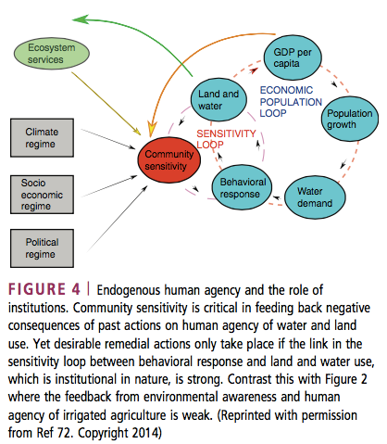
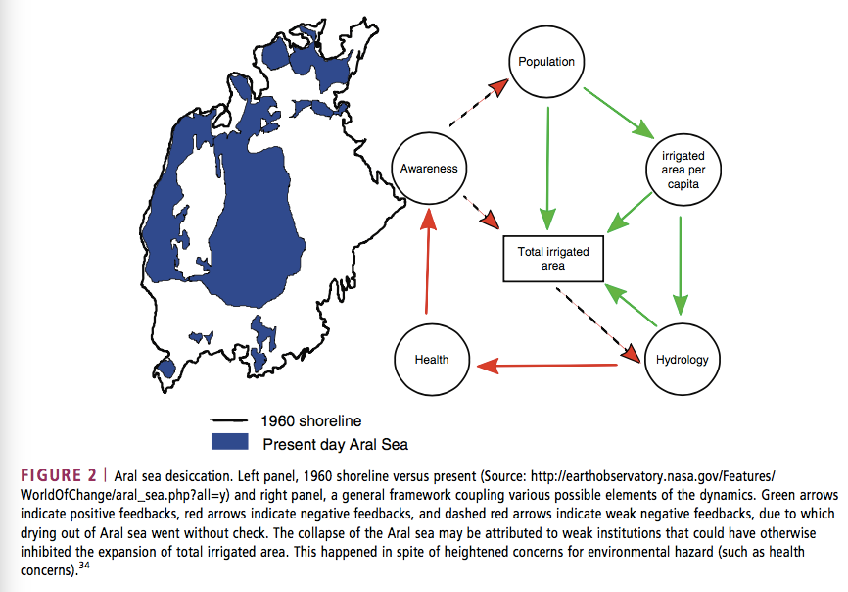
(Pande and Sivapalan 2017) review of sociohydrology
Socio hydrological knowledge generated so far has been influenced by a few selected phenomena
To endogenize human agency, there is the ‘pendulum swing’ phenomenon, or qualitative descriptions of behavior relating to population growth, levee rise, and flood occurrence. Both these approaches are in the form of a system of coupled differential equations that show an emphasis on system engineering and nonlinear dynamics. (can we use CE 295 stuff to model land use change and farmer behavior for our work?) one area that’s studied is the role of technology in ensuring a sustainable future (it doesn’t tend to, there are many unintended negative consequences). The competition between tech-mediated growth and environmental sensitivity endogenizes the human agency.
The field needs to include more diverse phenomena because knowledge can be biased by the paradoxes and the patterns people choose to study. All socio hydrological models are still low dimensional and focused on modeling temporal dynamics.
To add in spatial dimension, can endogenize the boundary conditions themselves, ie. Of trade or rainfall. This requires use to understand additional processes that connect socio hydrological entities in space, like trade, rivers, atmospheric fluxes. (this is very pertinent to our stuff, and perhaps speak to socio hydrology in the context of extending spatial emergent patterns in atmospheric connections, like ET falling as rain downwind.
Telecoupling in Land System Science, where location specific land cover dynamics is influences not just by local drivers of change such as population pressure but also distal coupled social environmental/land cover dynamics through flows such as trade and knowledge. Our project is similar – look at it in terms of telecoupling?

Slide 12
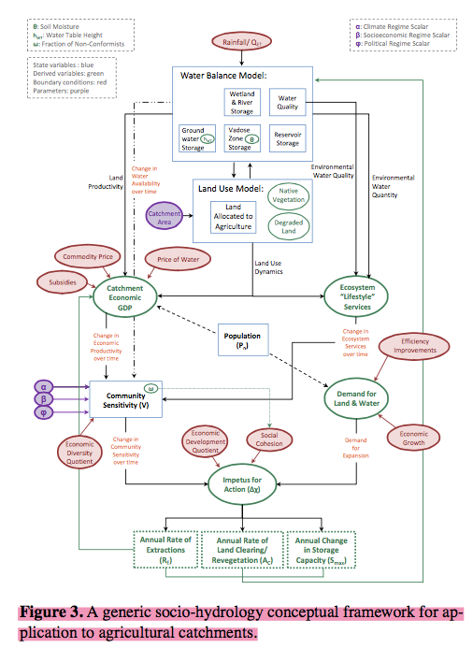
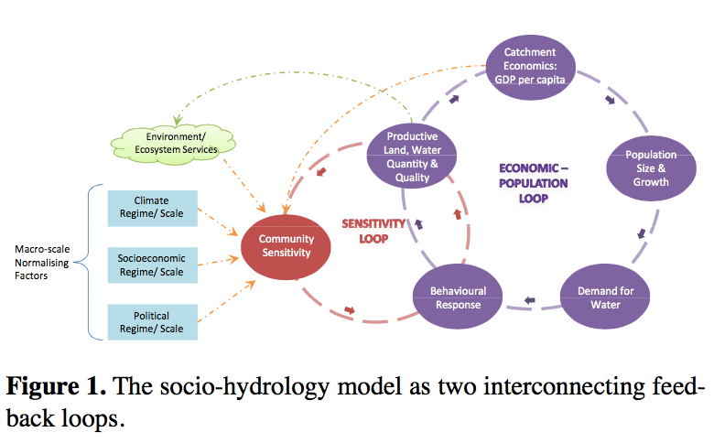
(Elshafei et al, 2014) – framework for socio hydrology models in agricultural basins
This could be the basis of the toy model in the dynamic sense – but it ignores spatial connections with different basins
The model framework has six coupled system dynamics: catchment hydrology, population, economics, environment, socioeconomic sensitivity and collective response. They introduced a socioeconomic driving variable (Community Sensitivity – or perceived level of threat to a community’s quality of life) and Behavioral Response variable – reflects land and water management decisions relevant to the hydrological context.
Used general systems theory to describe the systems – which has nonlinear tendencies with attractors to certain stable states and repelors from unstable states, and thresholds and rapid responses between state transitions. Negative feedbacks will stabilize the system; positive feedbacks will induce a shift to another position.
There are two key feedback loops: “economic-population loop” (as per capita economic gain increases, population and rate of growth increase, heightened demand feeds into water management decisions , water flows reduce causing deterioration in economic conditions, and demand for water and land reduces) and “sensitivity loop” (contains Community Sensitivity state variable which reflects community sensitivity to marginal change in water variables; as sensitivity increases, behavior will tend towards reducing community’s impact. For example, expansion phase with strong drive for anthropocentric behavior, i.e. positive feedback; followed by enviro-centric management due to negative feedbacks).
The six components of the framework: (1) catchment hydrology: must include water related management decisions relevant at catchment scale like land cover change, GW or surface water extraction, changes in the capacity for storage) that will support simulation of the coupled dynamics (2) population dynamics (3) economic function: benefit vs cost (4) ecosystem services function (5) sensitivity state variable: a function of national/regional scale factors like regional climate regime and national political/socioeconomic development; and local factors like local water availability, ecosystem services, GDP (6) Behavioral response (X) function which is driven by sensitivity and demand (which is the degree of inducement for agricultural expansion – i.e. relative importance of agri in the economy and population growth)

Slide 13
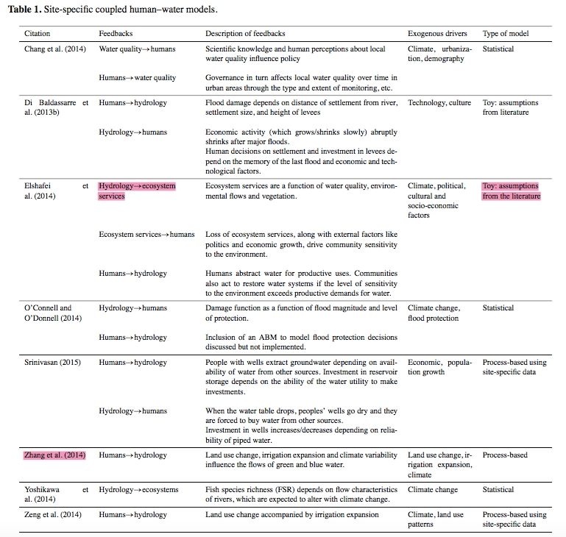
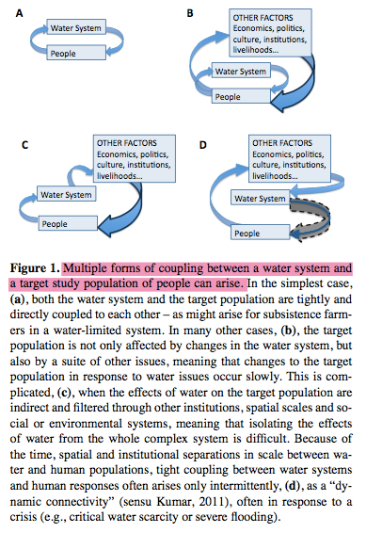
(Troy et al, 2015)
A toy model is one that makes assumptions from the literature. Look at the table they have for examples of toy models.
In socio hydrology, humans and their activities are part of the water cycle, instead of an external driver. Improved understanding of the relationships between human decision making and the water system itself may lead to better prediction, and thus management, of water systems.
Different water-society dynamics that are studied: because observational periods are often constrained, many studies are only able to explore the one-way influence of water -> humans or humans -> water. It’s also possible that in some cases one-way feedbacks are all that exist.
one-directional influence: studies that focus on the “natural systems paradigm” in which human action is externalized and treated as a perturbation to the natural hydrologic regime (Ximing Cai’s GW irrigation in High Plains is an example). The one-directional nature of influence in these studies probably is due to timescale separation between rapid timescales of human intervention in the water cycle and longer timescales on which these interventions alter ag productivity, or due to spatial scale separation (i.e. between international trade and local farmer decision-making)
Two-directional coupling: these couplings don’t necessarily change over time
Dynamic connectivity: two way coupling that changes with time. Perhaps the system will switch between one way and two way feedbacks, depending on the rate at which sensitivity develops. The system might switch between one way and two way feedbacks depending on the balance between supply and demand. The rate at which sensitivity develops is strongly socially mediated.
It is problematic to confine sociohydrologic studies to only strong two way human-water feedbacks; this tight coupling is actually a special case, arising in systems with simple water and social infrastructure, such as irrigated subsistence ag in a water limited region, or in situations with a water crisis. Social responses to hydrologic crises may be significantly delayed

Slide 14
(Troy et al, 2015)
Research methods have used a range of methods, including historical analysis, simplified systems of differential equations, and statistical-empirical analyses. A particular example comes from complex system studies, and it’s a method to evaluate causal relationships (e.g. information theory, synchronicity and time delays, and entropy-based measures); to reconstruct the underlying complex system based on time series measures (e.g. attractor reconstruction, recurrence metrics, etc.), and to analyze time series based on object oriented occurrences of patterns in the time series. Alternatively, try to do “randomized controlled trials” – which needs a strategy to identify random selections in real world empirical data.
The final method area in socio hydrology is modeling. Modeling approaches range from “toy” models consisting of a few coupled differential equations, to detailed region-specific models. Many of these models don’t depart from the current hydrological paradigm, but Elshafei does. Features like dynamic connectivity, threshold behavior, and multiple stable states are characteristic of nonlinear systems. To date, modeling studies tend towards being very specific, and thus hard to generalize beyond the case study, or very general and thus dependent on the construction of “environmental sensitivity” metrics, which are hard to measure or describe in concrete terms. In the future, the use of data analytics to unravel networks of cause and effect, in conjunction with numerical modeling to explore the potential behaviors that such networks can produce, could provide a robust and generalizable approach to understanding these systems.
Two major takeaways: first, that two way feedbacks between human and water systems don’t always exist and therefore it’s inappropriate to begin by assuming they do; and second, socio hydrology can draw on complex systems science and data analysis
Two ways to model human agency: top down approach to model society itself at time steps of years to decades, or start at level of human beings with institutions developing through personal relationships of individuals.

Slide 15
(Srinivasan et al, 2017)
There are three critiques on socio hydrology models: there’s absence of feedbacks between water and society; the models are created by scientists who don’t know what stakeholders actually care about; and models fail to connect global forces to local water resources.
These critiques arise because the models used for long term planning tend to be extensions of medium term planning models, which implement long term climate scenarios using simplistic assumptions of population, land use and cropping patterns. Lifestyle choices and societal goals are usually fixed in conventional predictive models, which is a problem because humans have agency: the capacity to think and act independently in response to new information. Models ignore the cultural and institutional context for water management decisions. However, even if we predict emergent phenomena due to human agency, we can’t predict extreme social disruptions such as wars, natural disasters, new technologies or social movements. These “black swan” events mean that models should be stress tested to assess system robustness.
Second, models tend to highlight aggregate benefits such as total food and energy production, but not distributions of benefits and costs. Inequality and power differentials are a kind of feedback that would be missed if water users were treated as a single homogeneous group.
Third, place-based studied are problematic because the basin no longer captures geographical “boundedness”.
Water managers want to know a portfolio of options, how actors will respond to them, and welfare consequences for which people and over what time frame (i.e. want a possibility space) instead of a quantitative, probabilistic distribution of water demand and supply for a particular time slice.
Comparative case studies and building generic sociohydrological models that aim to replicate emergent phenomena observed in multiple locations is a good start. Goal should not be to create a “model of everything”; the model scope must still depend on the types of policies and future conditions the model aims to evaluate.
Need new data sources: big data, citizen science, participatory monitoring, new sensing technologies or satellite data.

Slide 16
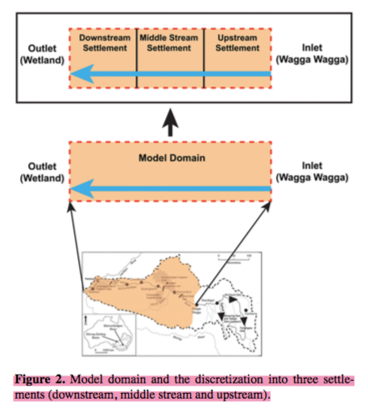
(Emmerik et al, 2014) – dynamic model of Murrimbidgee River (MRB)
Data shows a pendulum swing between agricultural development and restoration of ecosystem services. This model has coupled nonlinear ODEs to describe interaction between five state variables: reservoir storage, irrigated area, human population, ecosystem health, and environmental awareness. These equation are:
Hydrology equation (water balance) including irrigation water use. The model is conditioned such that if there is a persistent deficit in the water available to meet irrigation demand, a reservoir is introduced endogenously to mitigate deficit.
Irrigation equation (irrigation area per capita as function of water availability, tech change and environmental degradation
population equation (includes relocation inside basin). The model assumes people move in or out of a region based on its relative attractiveness level, equal to per capita irrigation potential.
Ecology equation (simulates wetland health only) wetlands are recharged when flow exceeds a prescribed threshold release from the downstream settlement.
Environmental awareness equation (tracks awareness of wetland health only) – environmental awareness happens when wetland quality degrades below a threshold. If wetlands are fine over long period of time, awareness decreases over time (i.e. awareness is a memory bank that accumulates when environment degrades and depletes during healthier times).
Explicit interconnections are built in between these five equations through assumed constitutive relationships to allow feedback. These equations are NOT prescribed; rather they are obtained by calibration using expert knowledge and desire to keep it simple and realistic.
Wealth, technology, yield, and crop water demand connect irrigated area per capita to hydrology equations. Technology increases as gross basin product (GBP) increases. Technology is an endogenous var and in turn it leads to higher yield, reduced crop water demand, increased irrigated land per capita.
Why are the red and green arrows labeled the way they are? Red means something that goes towards more environmentally conscious behavior? Read about feedback loops…

Slide 17
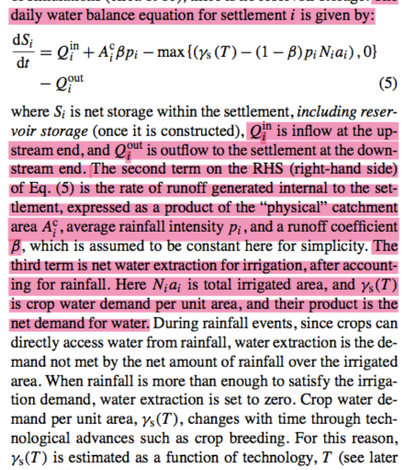
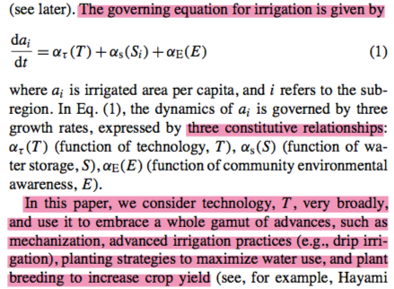
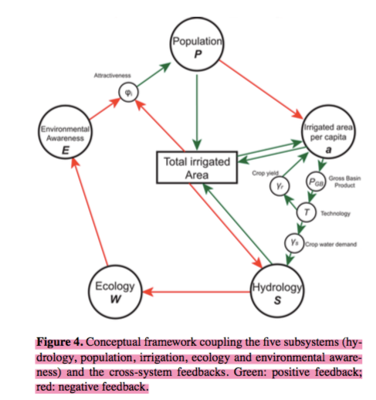
(Emmerik et al, 2014)
The external drivers are rainfall time series, upstream flow, and global food price of rice in particular, which acts as a surrogate.
There are a lot of parameters to be calibrated, and they did sensitivity analysis to determine how prone it is to equifinality.

